Slide 1
MVP to MVVM
An Introduction to
Model-View-ViewModel
Presented by:
Jason Lepp
Mo Khan
Craig Anderson

Slide 2
Outline
Reviewing Model-View-Presenter
Introduction to Model-View-ViewModel
What is it? Why use it?
Binding/DataContext
Communicating changes to the view.
User Interaction
Difficulties with Model-View-ViewModel
What are they?
How do we solve them?
Summary
Notes:
Communicating Changes
INotifyPropertyChanged
INotifyCollectionChanged (ObservableCollection<T>)
User Interaction
ICommand
IDataErrorInfo
IValueConverter

Slide 3
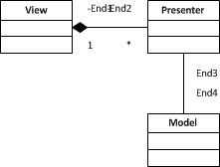
Reviewing Model-View-Presenter
Two Flavours
Supervising Controller
Passive View
There is a lot of ____ between the View and Presenter
Plumbing to be done
Chatter back and forth
Presenter has reference to View to tell it what to do
Presenter interacts with the Model to complete behaviours
Notes:
Ask audience about what they use? Winforms? Presentation patterns?
MVP -> Supervising Controller: “Factor the UI into a view and controller where the view handles simple mapping to the underlying model and the controller handles input response and complex view logic.”
MVP -> Passive View: “A screen and components with all application specific behavior extracted into a controller so that the widgets have their state controlled entirely by controller.”
Next -> overview of the app

Slide 4
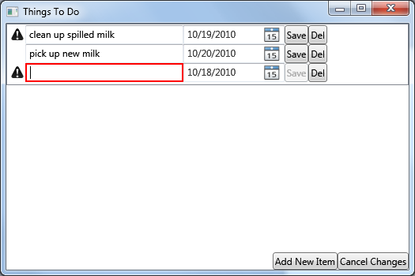
Things To Do – Sample App
Notes:
Overview of application.
Add/remove item
Validation
Notifications
Next -> Show the MVP code.

Slide 5
Why Move to Model-View-ViewModel
Less Code
Loosely Coupled
Easier plumbing
Increased Test Coverage
Focus on design without effecting behaviour
Simplicity

Slide 6
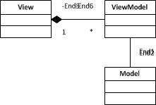
Introduction to Model-View-ViewModel
ViewModel knows nothing of the View
View knows which properties it must bind to
ViewModel is bound to the View
Communicates updates to the View via events
Behaviour is executed through commands which interact with the Model

Slide 7
Difficulties with Model-View-ViewModel
Some Controls don’t bind well
Bindings are strings
XAML Oddities

Slide 8

Contact Us
Jason Lepp
awesome@arcresources.com
Mo Khan
mocheen@arcresources.com
Craig Anderson
justKeepingUp@arcresources.com

